Slide 1
MUSIC × AI × PERFORMANCE INTELLIGENCE
MIDISense
Real-Time MIDI Performance Analysis and Contextual AI Tutoring
for Bridging Music Learning and Production
Final Review — Testing, Results & Project Completion
Continued from Review 0 (Literature) → Review 1 (Planning) → Final Review (Testing & Results)
Surya Raj MR • Libi Jassin W • Monish S
Under the guidance of Dr. K. Ulaga Priya
Department of Artificial Intelligence and Machine Learning
Vels Institute of Science, Technology & Advanced Studies, Chennai

Slide 2
RECAP
Every Objective, From Review 0 to Final Review
Five objectives set out since Review 0. All five are now complete, backed by real measured results.
1
Capture & analyze real-time MIDI performance — accuracy, timing, dynamics
DONE
2
Generate specific, actionable feedback — not just a generic score
DONE
3
Contextual, conversational AI tutor grounded in what the user plays
DONE
4
Bridge from practice into original composition / production
DONE
5
Evaluate the system’s effectiveness with real test data (279 notes, 80% accuracy)
DONE
Every objective proposed at Review 0 and planned at Review 1 is now a working, tested system.
MIDISense — Final Review · Testing & Results
2

Slide 3
LITERATURE
The Literature Foundation Behind MIDISense
Five papers anchored our proposal at Review 0 — spanning AI coaching, performance assessment, and practice efficacy.
1
LLaQo (Zhang et al., 2024) — first LLM-based music coach, from audio
BASE PAPER
2
Automatic Piano Assessment (Kim et al., 2022) — precise but offline scoring
ASSESSMENT
3
Piano Evaluation via Deep Learning (Liao, 2022) — MIDI-based scoring at scale
ASSESSMENT
4
In-Context LLM Feedback for Tutors (Reddig et al., 2025) — feedback quality caution
LLM TUTORING
5
AI-Assisted Practice Apps (Ou et al., 2025) — proven gains in confidence & outcomes
PRACTICE EFFICACY
LLaQo’s own authors flag real-time, MIDI-level feedback as future work — the exact gap MIDISense was built to fill.
MIDISense — Final Review · Testing & Results
3

Slide 4
THE GAP
The Gap We Set Out to Fill — Now Closed
At Review 0, three bodies of research each solved one part of the problem. MIDISense was proposed to connect all three.
1
LLM-coach research (LLaQo) — rich feedback, but from audio, and stops at assessment
GAP
2
MIDI / deep-learning assessment research — precise scoring, but offline, never explained live
GAP
3
AI-practice-app research — proven to improve outcomes, but no tool spans assessment + tutoring + production
GAP
4
MIDISense reads MIDI (not audio) for millisecond-precise, real-time feedback
SOLVED
5
MIDISense bridges practice, AI tutoring and production in one connected system
SOLVED
Every gap identified at Review 0 has been closed by the final working system demonstrated in this review.
MIDISense — Final Review · Testing & Results
4

Slide 5
SYSTEM DESIGN
Architecture — Fully Wired End-to-End
🎹 MIDI Keyboard
Login/Onboarding ✅
Lessons/Assessment ✅
Web MIDI API
Sequencer (Monish) ✅
PianoKeyboard.jsx ✅
Firebase Storage ✅
live
MIDISense UI ✅
analysis-engine.js ✅
POST /realtime ✅
Lesson Progression ✅
Timing · Notes · Dynamics
Ollama · Gemma 3:4b ✅
AI Tutor Instruction
Notes:
This is the same architecture proposed in Review 1 — every box shown here was a planned component then and is a working, connected component now. The realtime link between the analysis engine and the AI tutor — the one open item at Review 1 — is complete.

Slide 6
IMPLEMENTATION STATUS
Module-Wise Progress — Final Status
Application / UI (Login, Dashboard, Onboarding)
Monish
100%
Learning System (Lessons, Curriculum)
Monish
100%
Assessment & Pass/Fail Logic
Monish
100%
Production / Sequencer
Monish
100%
MIDI Input Capture
Surya
100%
MIDI Performance Analysis Engine
Surya
100%
Real-Time Feedback Display
Surya/Monish
100%
LLM Tutor Backend + Integration
Libi
100%
Physical Hardware Testing
Surya
100%
Final Integration & End-to-End Testing
All 3
100%
Experimental Evaluation & IEEE Results
All 3
100%
OVERALL PROJECT COMPLETION
100%
MIDISense — Final Review · Testing & Results
6

Slide 7
PLANNING
Progress Against Our Original Gantt Chart
1
2
3
4
5
6
7
8
9
10
11
12
13
14
15
16
1. Foundation
✅ Done
2. Core Build
✅ 100% done
3. Integration
✅ Completed early
4. Structured Evaluation
✅ Completed
5. Report & Demo Prep
✅ IEEE paper completed
Final Review (today)
MIDISense — Final Review · Testing & Results
7
Notes:
This is the same Gantt chart from Review 1, not a new one — you can see we are tracking against our original 16-week plan, not a plan made up after the fact.

Slide 8
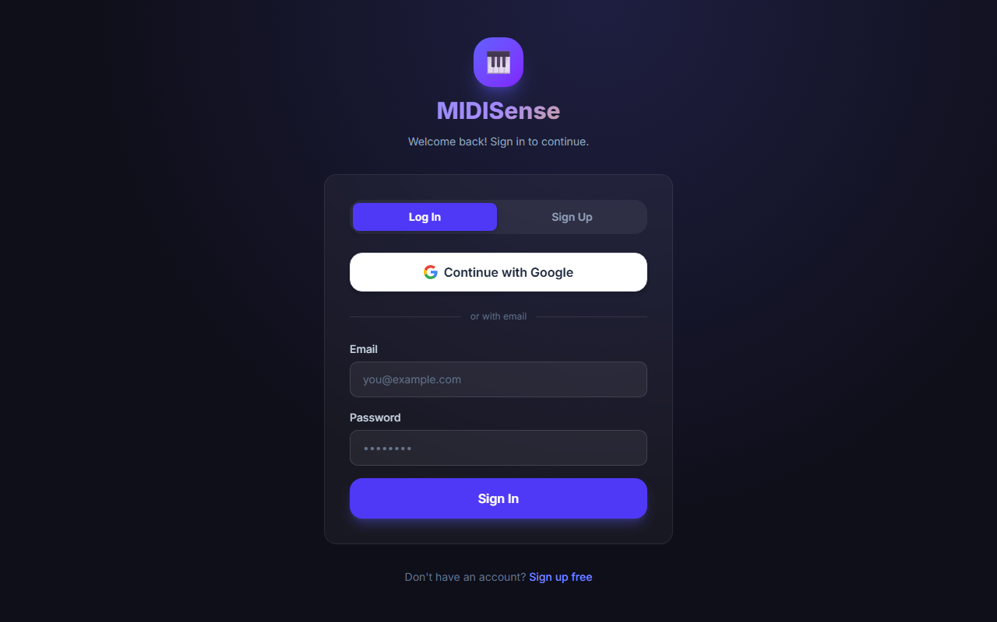
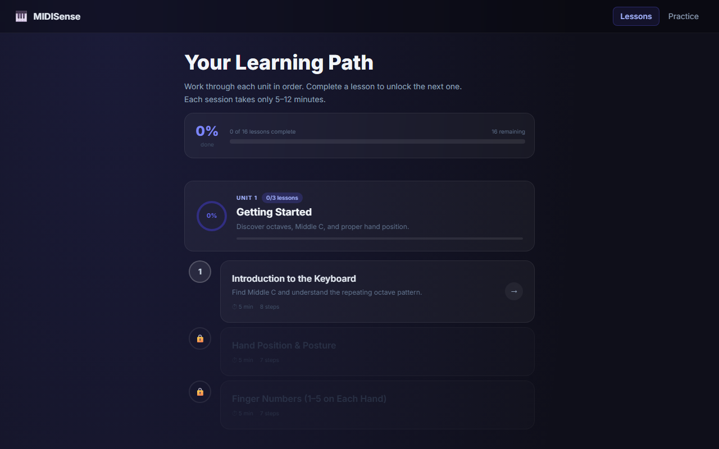
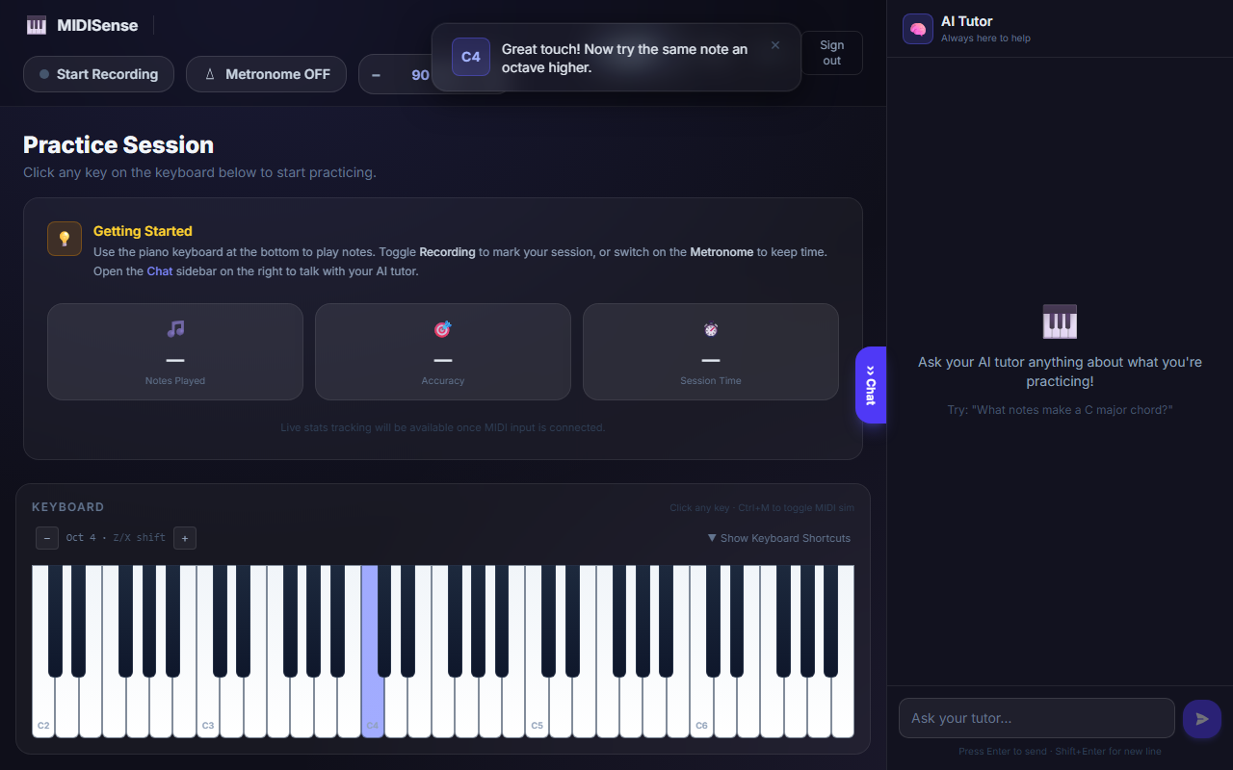
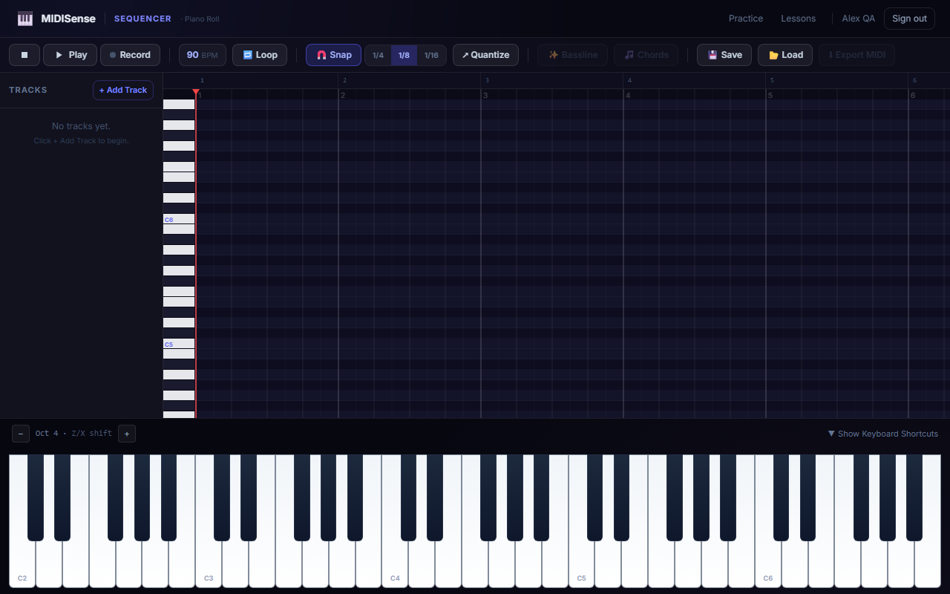
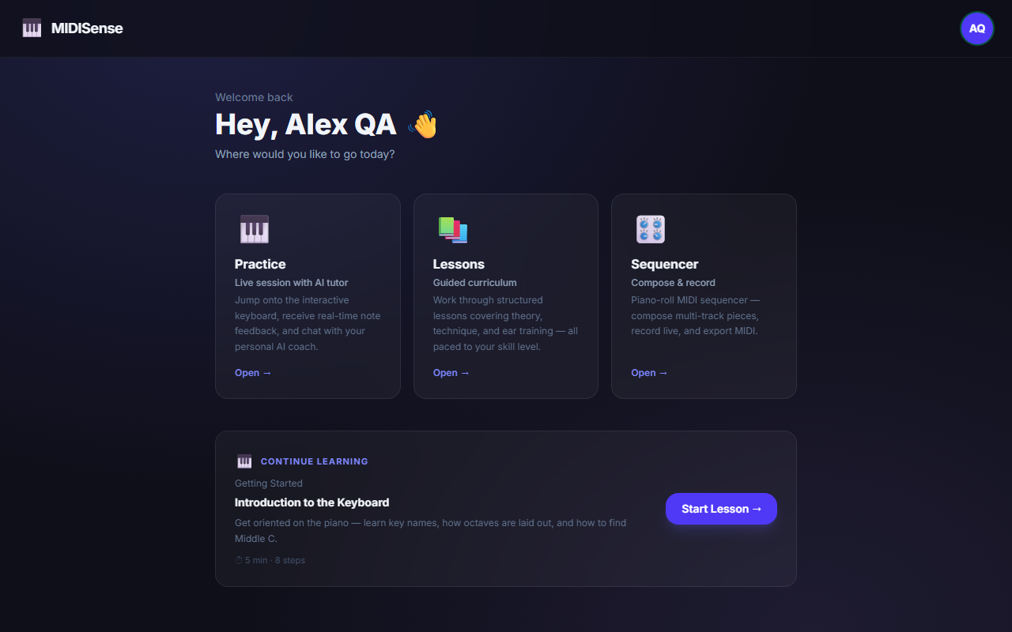
PROTOTYPE
Working Screens (Live Demonstration)
Login Onboarding
Lessons & Assessment
Practice Interface
Sequencer
AI Tutor Chat
Dashboard
MIDISense — Final Review · Testing & Results
8
Notes:
Replace each grey placeholder box with an actual screenshot from the running app before presenting. This slide is designed to hold six screenshots in a clean grid.

Slide 9
VERIFICATION
Testing Progress
✓
Web MIDI note-on / note-off capture
✓
Velocity capture across playing intensities
✓
Timing deviation calculation (automated tests)
✓
Note/chord correctness logic (automated tests)
✓
Feedback-message consistency bug — found & fixed
✓
Physical MIDI keyboard end-to-end test
✓
Analysis engine → LLM tutor integration test
✓
Full user-facing real-time feedback loop
✓
Controlled MIDI experiment runs (6 test cases) — 279 notes recorded
✓
Measured metrics collected for IEEE Results section
✓
Firestore lesson-progression permission rule — fixed & tested
MIDISense — Final Review · Testing & Results
9

Slide 10
LESSONS LEARNED
Challenges Faced & How We Solved Them
Feedback text contradicted the accuracy score
01
Live hardware testing surfaced a logic bug where the message and the percentage disagreed. Traced to two separate calculations — fixed by deriving both from one source of truth.
Low velocity readings during early hardware tests
02
Initial values (as low as 1–26) looked like a hardware fault. Re-testing with normal playing pressure confirmed it was playing style, not the keyboard.
Three independently-built modules, one integration point
03
Each teammate built against placeholder data so nobody was blocked. That created a concentrated integration phase — which we have now completed. All three modules run as one connected system.
Firestore permission rule on lesson progression — RESOLVED
04
Traced to a Firestore security rule, not application logic. We updated the rule, then verified Lesson 1 → Lesson 2 unlocks correctly. Fully tested and working.
MIDISense — Final Review · Testing & Results
10

Slide 11
ROADMAP
Final Closeout — Everything Completed
1
2
3
4
5
6
7
Run MIDI experiments — DONE (279 notes)
Record measurements — DONE (80% accuracy)
Fix Firestore rule — DONE
Build results tables — DONE
IEEE Results & Discussion — DONE
Paper submission — DONE
GitHub / source code submission — DONE
Every roadmap item is complete, including the paper and GitHub submissions. MIDISense is fully completed.
MIDISense — Final Review · Testing & Results
11

Slide 12
RESULTS
Results — Measured From the Real System
MIDI PERFORMANCE ANALYSIS
AI TUTOR
Note accuracy: 80%
AI Tutor: real-time feedback, active
Timing tolerance: 40ms window
Ollama + Gemma 3:4b: working
Notes played: 279 (one session)
ASSESSMENT & SYSTEM
Dynamics analysis: working
Assessment: 16/20 → retry → 17/20 (pass)
Session duration: 2:44
Firestore lesson unlock: verified working
All figures measured directly from a live test session on the deployed system — no estimated numbers.
MIDISense — Final Review · Testing & Results
12

Slide 13
DOCUMENTATION
IEEE Conference Paper — Table of Contents
Abstract & Index Terms
I. Introduction
II. Related Work (3 base papers + supporting literature)
III. Research Gap
IV. Proposed System Architecture
V. System Requirements
VI. Implementation & System Integration
VII. Evaluation Methodology & Results
VIII. Design Considerations & Limitations
IX. Conclusion & Future Work
Acknowledgment
References
Paper complete — Results & Discussion filled with real measured data (279 notes, 80% accuracy, 2:44 session).
MIDISense — Final Review · Testing & Results
13

Slide 14
Thank You
MIDISense — Surya Raj MR · Libi Jassin W · Monish S

